Slide 1
Support Vector Machines

Slide 2

Overview
Notes:
升维，向高维映射

Slide 3
Linear Classifier
w·x + b =0
w
w·x + b <0
w·x + b >0
Notes:
法向量w

Slide 4
Distance to Hyperplane
x
x'
Notes:
点到超平面的距离

Slide 5
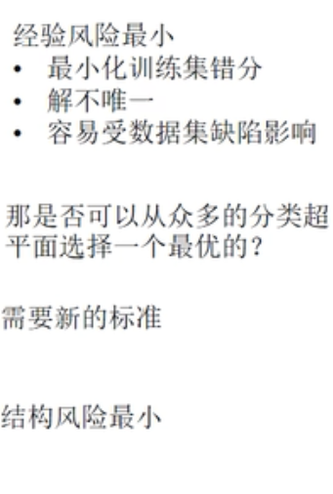
Selection of Classifiers
Which classifier is the best?
All have the same training error.
How about generalization?
?
Notes:
训练误差都是零
测试误差不一样

Slide 6
Unknown Samples
B
A
Classifier B divides the space more consistently (unbiased).
Notes:
B 比 A 好

Slide 7
Margins
margin
Support Vectors
Support Vectors
Notes:
margin英[ˈmɑːdʒɪn]美[ˈmɑːrdʒɪn]
n.页边空白; 白边; (获胜者在时间或票数上领先的)幅度，差额，差数; 余地; 备用的时间(或空间、金钱等);
间隔
分界面平移，可以平移的距离就是间隔

Slide 8

Margins
The margin of a linear classifier is defined as the width that the boundary could be increased by before hitting a data point
Intuitively, it is safer to choose a classifier with a larger margin
Wider buffer zone for mistakes
The hyperplane is decided by only a few data points
Support Vectors
Others can be discarded!
Select the classifier with the maximum margin
Linear Support Vector Machines (LSVM)
How to specify the margin formally?
Notes:
边界周围的点，决定margin
内部的点，对margin 不起任何作用

Slide 9
Margins
“Predict Class = +1” zone
M=Margin Width
x⁺
x⁻
wx+b=1
wx+b=0
“Predict Class = -1” zone
wx+b=-1
Notes:
最大化分类间隔
平行 等间距

Slide 10
Objective Function
Correctly classify all data points:
Maximize the margin:
Quadratic Optimization Problem
Minimize
Subject to
Notes:
约束 所有样本点 满足经验风险最小
最小化结构风险

Slide 11
Lagrange Multipliers
Dual Problem
Quadratic problem again!
Notes:
l 训练样本个数

Slide 12
Solutions of w & b
inner product
Notes:
S 所有支持点，点集

Slide 13
An Example
x₂
(1, 1, +1)
x₁
(0, 0, -1)
Notes:
例子 2个点

Slide 14
Soft Margin
ε₁
ε₂
wx+b=1
ε₃
wx+b=0
wx+b=-1
Notes:
线性不可分 线性分割有误分的情况
软间隔
每一个样本点，有一个松弛变量，大于等于零
有一个个性化的分割超平面

Slide 15
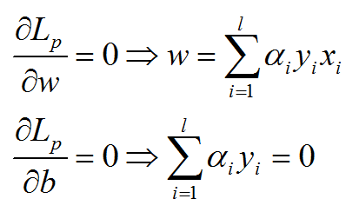
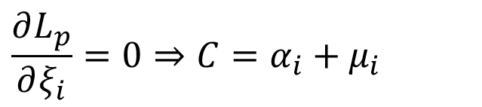
Soft Margin
Same as before
$$\frac{∂L_{p}}{∂ξ_{i}}=0⇒C=α_{i}+μ_{i}$$
Notes:
目标函数，变换不大
至少多了约束 <=C

Slide 16
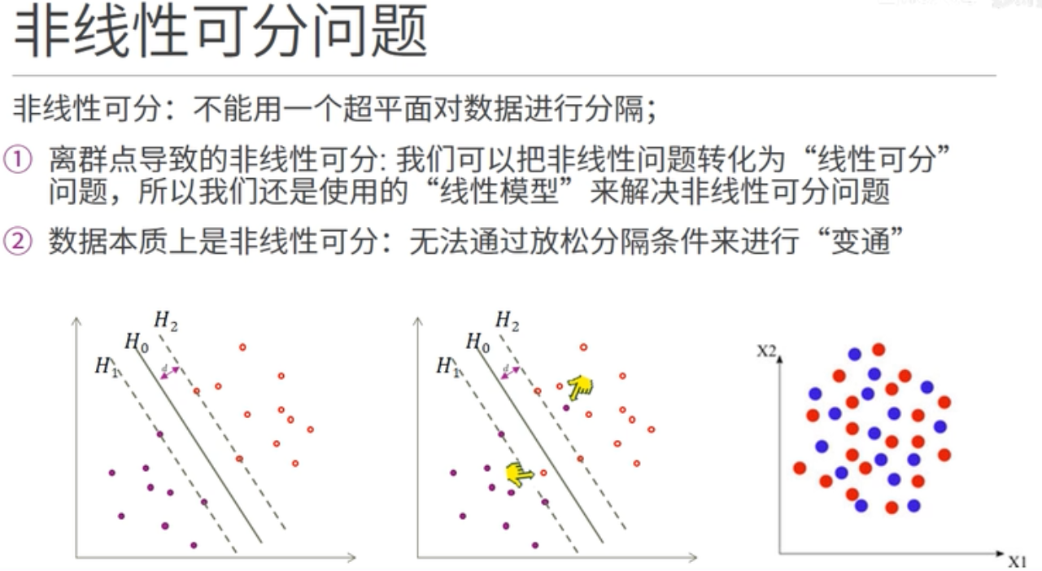

Slide 17
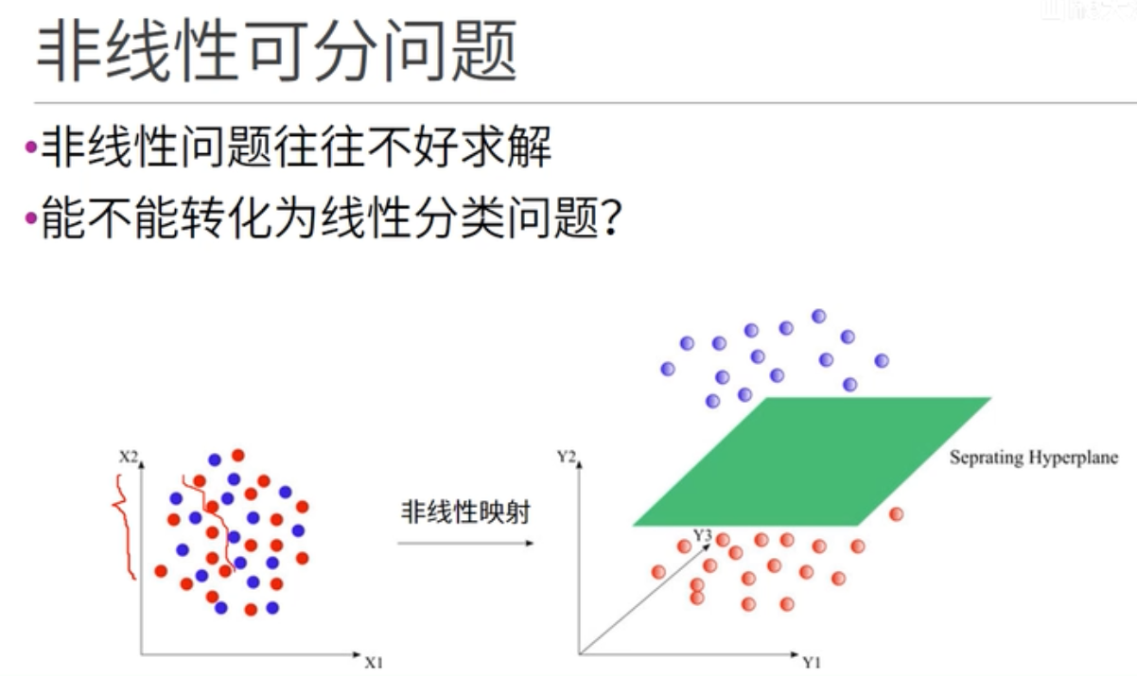

Slide 18
Non-linear SVMs
0
x
0
x
x²
x

Slide 19
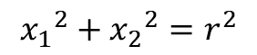
Feature Space
x₂
Φ: x → φ(x)
x₂²
x₁
$${x_{1}}^{2}+{x_{2}}^{2}=r^{2}$$
x₁²
Notes:
特征空间

Slide 20
Feature Space
x₂
Φ: x → φ(x)
x₁
Notes:
第3维度 x1^2+x2^2

Slide 21
Quadratic Basis Functions
Constant Terms
Number of terms
Linear Terms
Pure Quadratic Terms
Quadratic Cross-Terms

Slide 22
Calculation of Φ(x_{i} )·Φ(x_{j} )

Slide 23
It turns out …

Slide 24
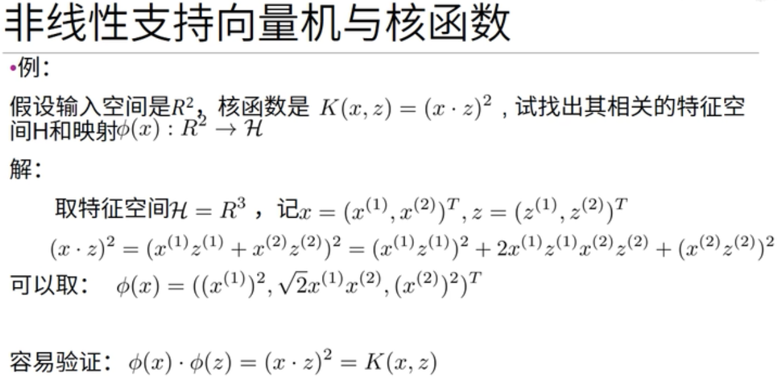
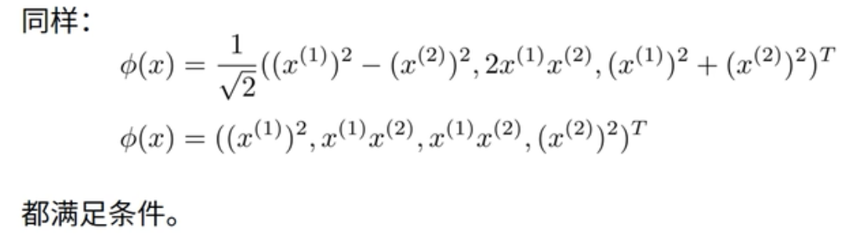
Notes:
映射函数phi 不唯一

Slide 25
Kernel Trick
The linear classifier relies on dot products x_{i}x_{j} between vectors.
If every data point is mapped into a high-dimensional space via some transformation Φ: x → φ(x), the dot product becomes: φ(x_{i})φ(x_{j})
A kernel function is some function that corresponds to an inner product in some expanded feature space: K(x_{i},x_{j}) = φ(x_{i})φ(x_{j})
Example: x=[x₁,x₂]; K(x_{i},x_{j}) = (1+x_{i}x_{j})²
Notes:
高维空间 提供可分性
但计算量增加很少

Slide 26
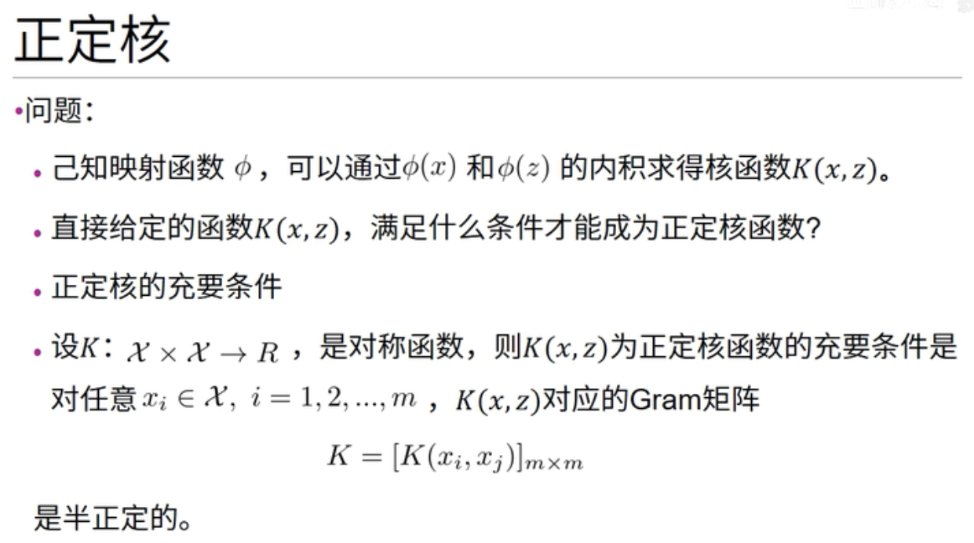
Notes:
m个样本点

Slide 27
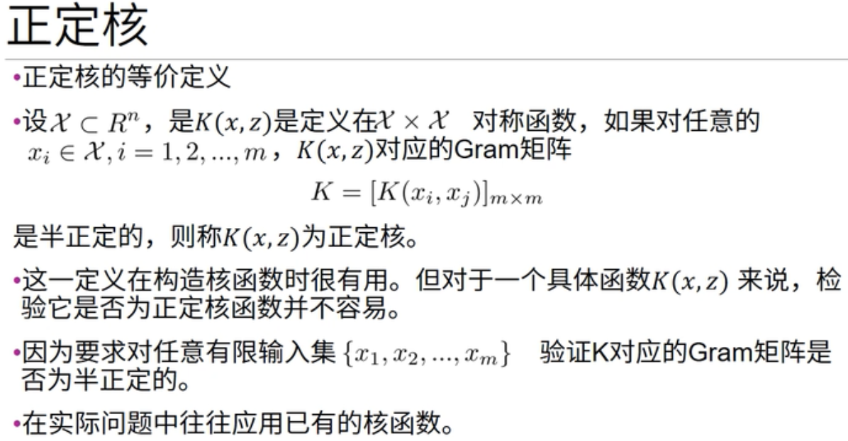

Slide 28
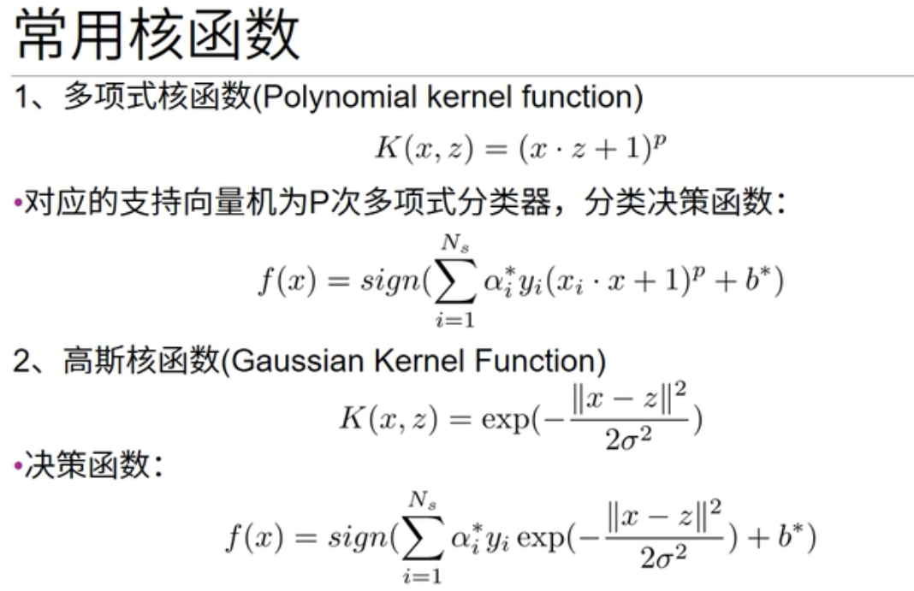
Kernels

Slide 29
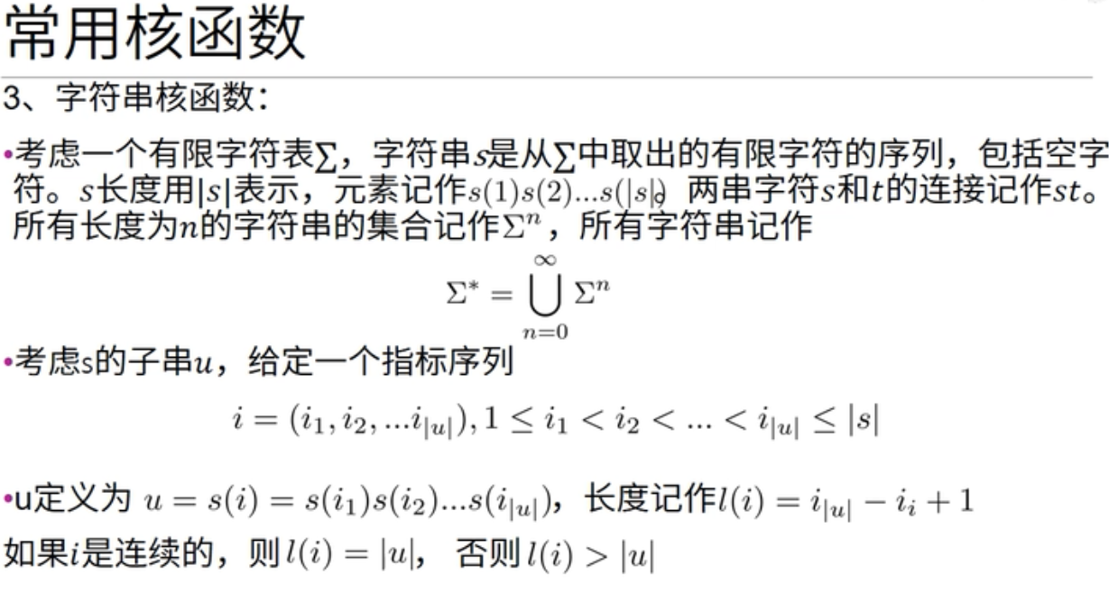

Slide 30
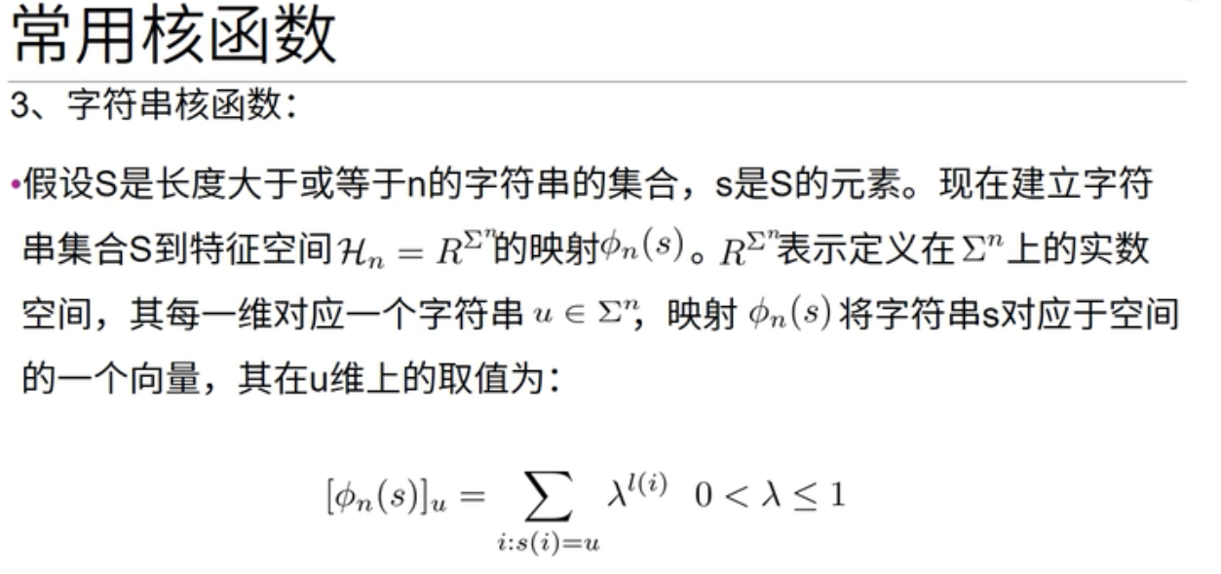

Slide 31
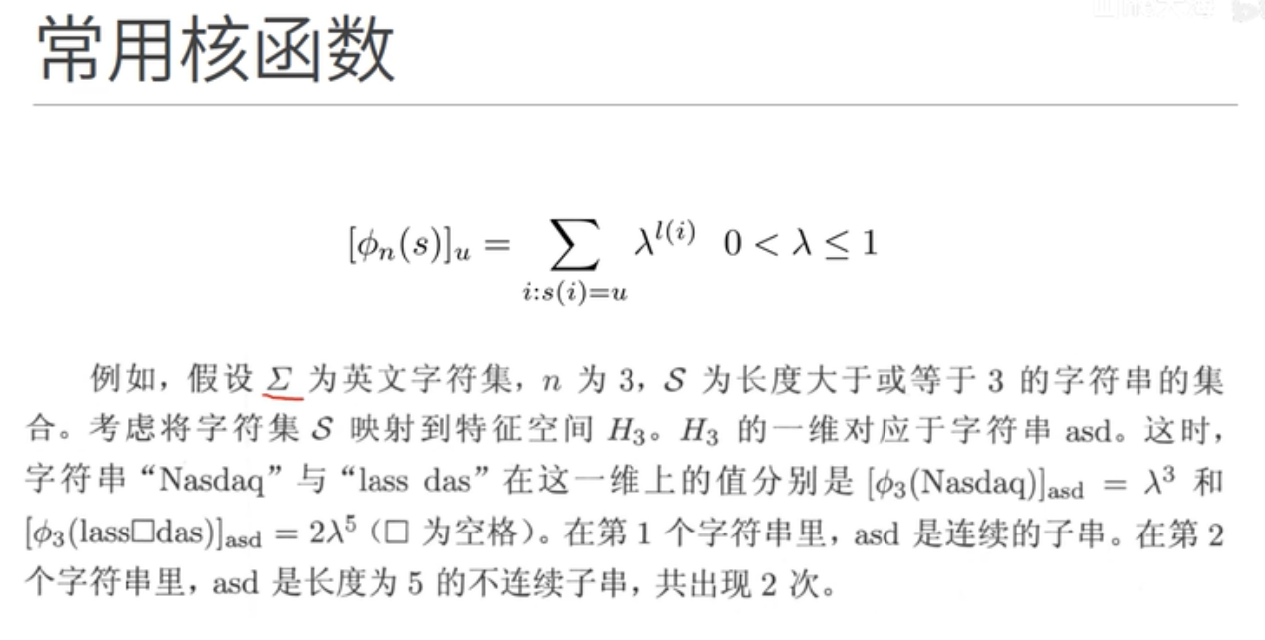

Slide 32
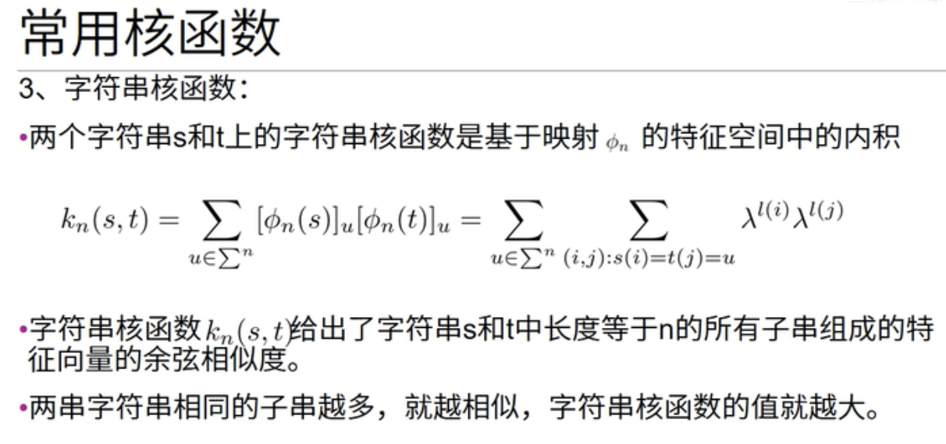

Slide 33
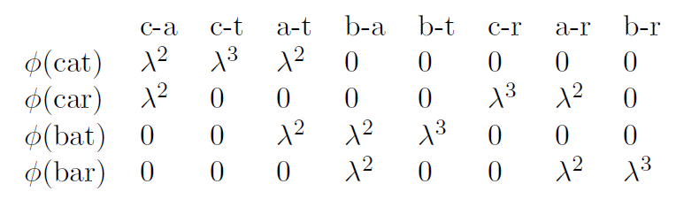
String Kernel
Calculate the similarity between text strings.
The substring ‘c-a-r’ is present in both Car and Custard.
Each substring corresponds to a dimension of the feature space.
Notes:
Lodhi, Huma; Saunders, Craig; Shawe-Taylor, John; Cristianini, Nello; Watkins, Chris (2002). "Text classification using string kernels". Journal of Machine Learning Research: 419–444.

Slide 34
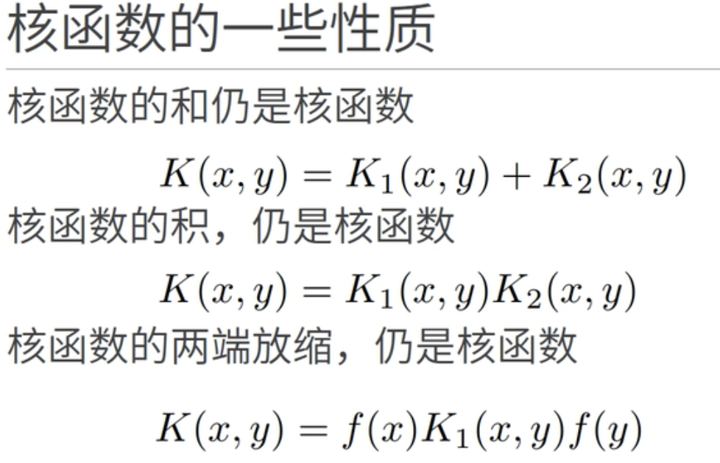

Slide 35
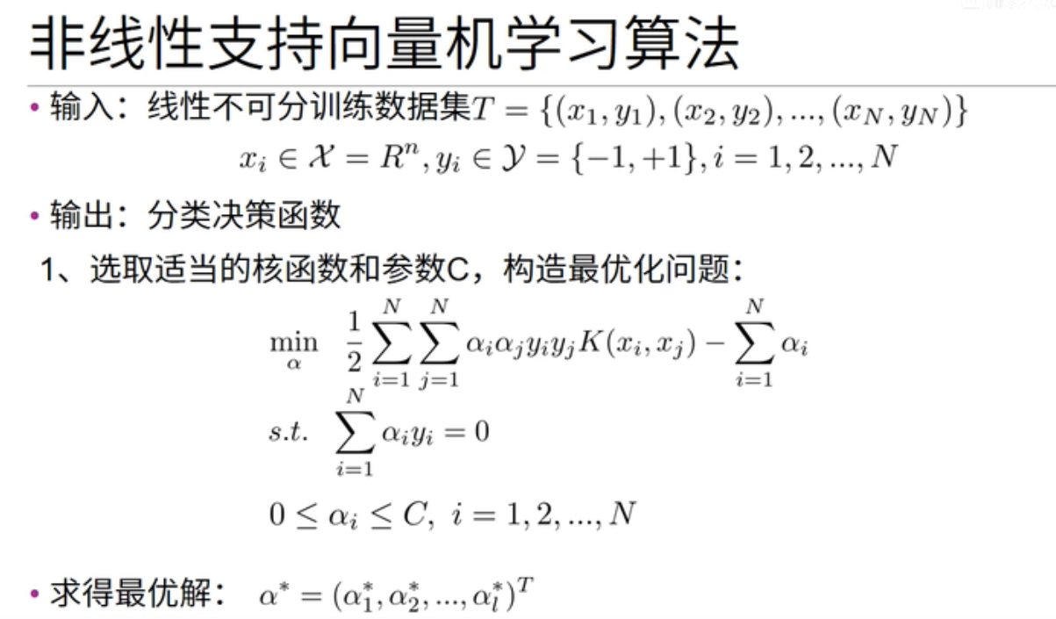

Slide 36
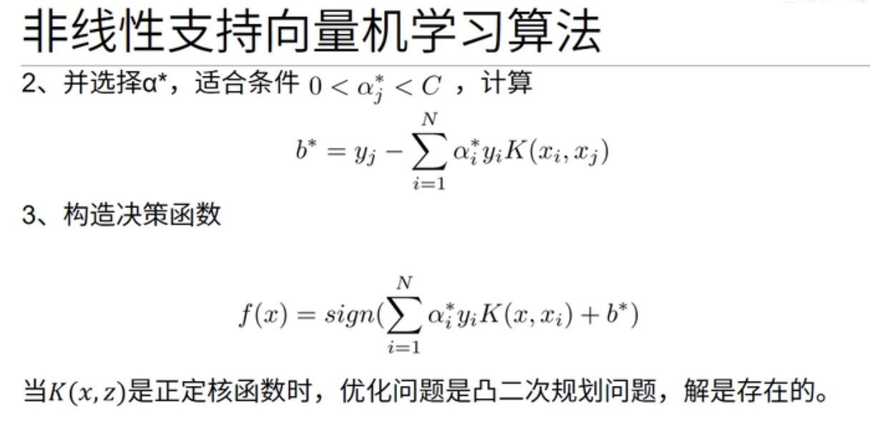

Slide 37
Solutions of w & b

Slide 38
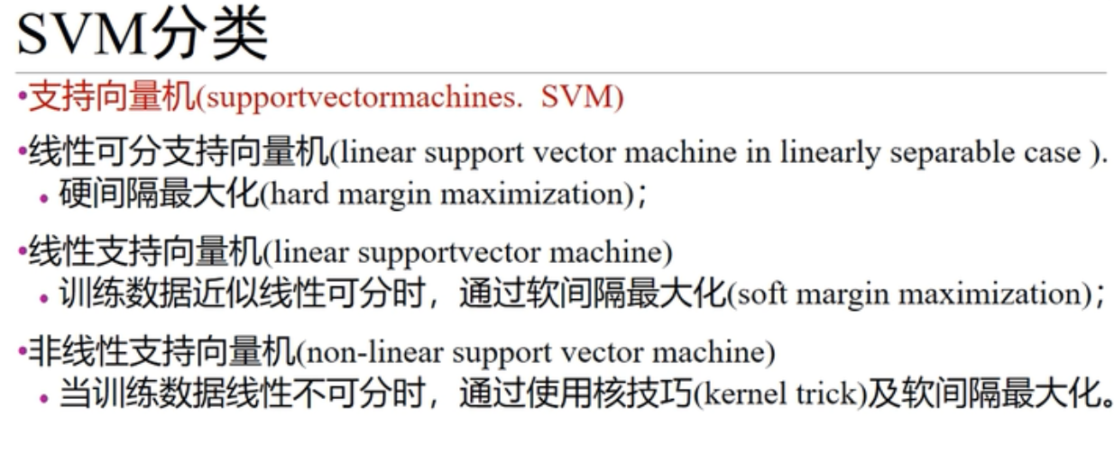

Slide 39
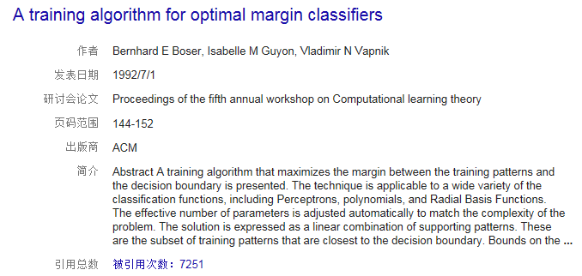
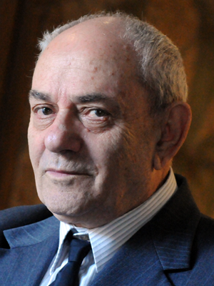
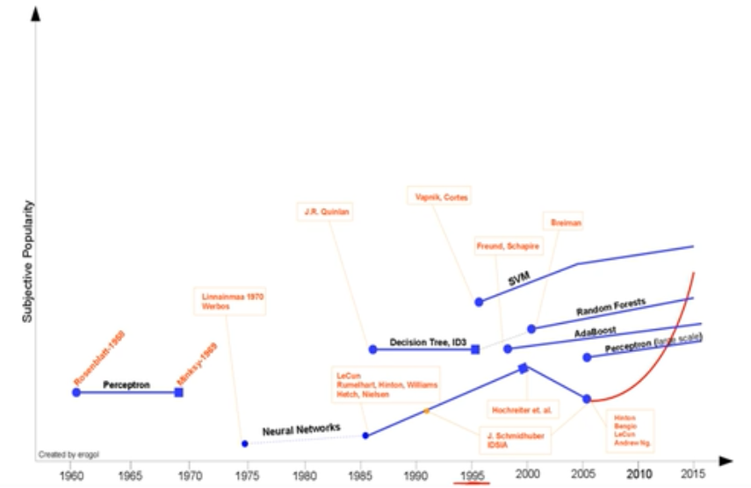
SVM Legend

Slide 40
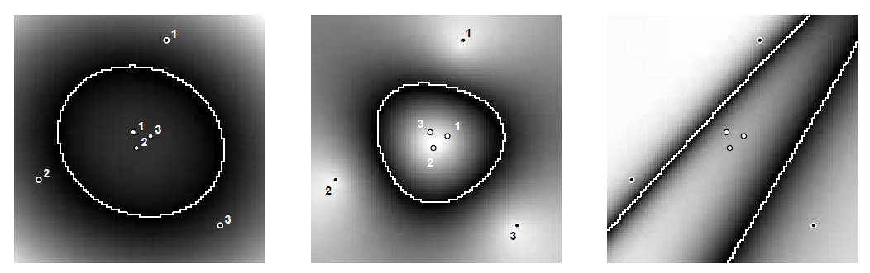
Decision Boundaries
Polynomial
RBF
ANN
Notes:
ANN是指由大量的处理单元(神经元) 互相连接而形成的复杂网络结构，是对人脑组织结构和运行机制的某种抽象、简化和模拟。人工神经网络（Artificial Neural Network，简称ANN ）

Slide 41
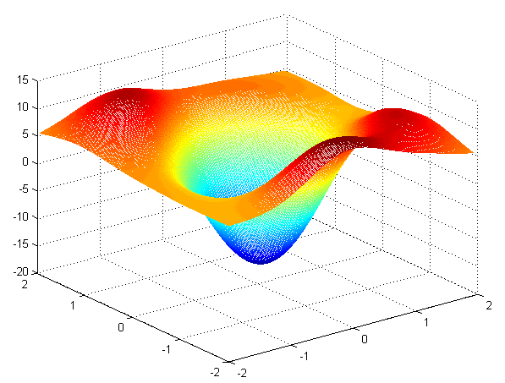
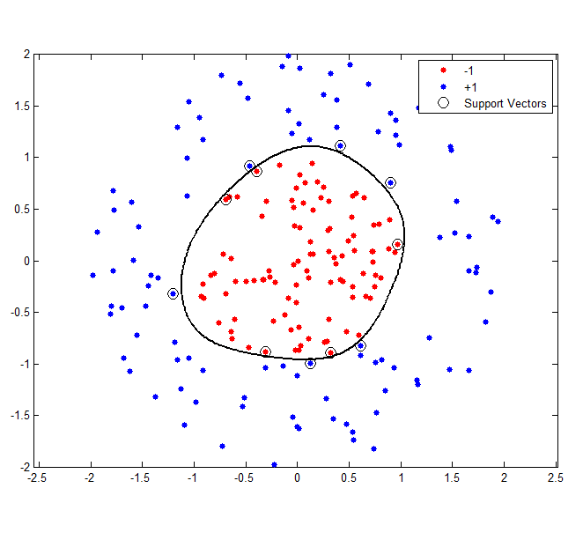
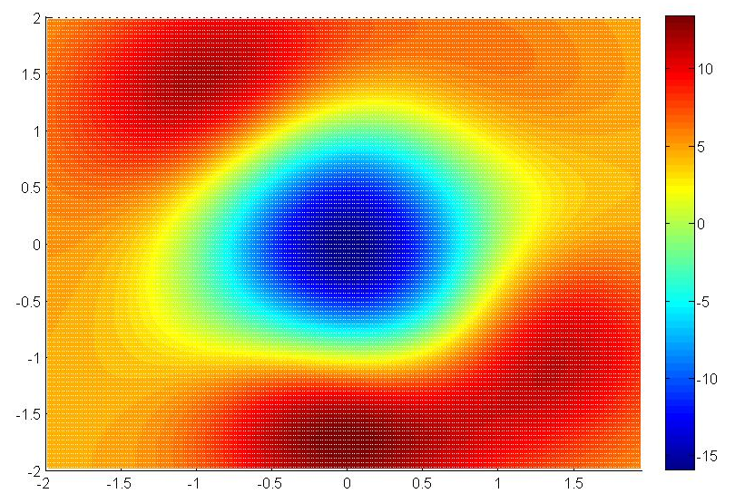
Decision Boundaries

Slide 42


Model Capacity
A straight line can classify (shatter) a certain set of 3 (not 4) points,
regardless their labels.
Notes:
shatter英[ˈʃætə(r)]美[ˈʃætər]
v.(使)破碎，碎裂; (使感情、希望或信念等)粉碎，破灭; 被粉碎; 被破坏; 使极为惊愕难过; 给予极大打击;n.碎片; 碎块; 落花（叶等）;

Slide 43
Model Capacity
A rectangle can classify (shatter) a certain set of 4 points,
regardless of their labels.

Slide 44
VC Dimension
The VC dimension of a model M is h if there exists a set of (up to) h points that can be shattered by M.
The h value of a hyperplane in R^{n} is n+1.
The h value of DT is roughly the number of internal nodes.
The h value of SVM depends on the kernel function in use.
VC dimension is pessimistic: arbitrary assignment of labels.
Real data sets: points with same labels tend to be close to each other.
N: Number of training samples
Notes:
pessimistic英[ˌpesɪˈmɪstɪk]美[ˌpesɪˈmɪstɪk]
adj.悲观的; 悲观主义的;
实际样本有规律
置信度
越复杂模型，h 值越大

Slide 45
